Slide 1
FIGURE 1
Posterior (top-down) view of racetrack detectors (i)
Patient feet direction
Inferior detectors – stationary
“straightaways”
MR/PET guided biopsy
lateral access when
retracted
Breast
Curved, racetrack
detectors – retractable
or hinged
Each square represents a detector module which is a sub-unit of the entire system
Hinge
Superior detectors – stationary
“straightaways”
Patient head direction
Detectors can be:
Continuous (the continuous version of what is shown here),
Monolithic blocks (a single crystal read-out by position sensitive detectors),
Discretized array blocks (multiple crystals on a position sensitive detector),
Completely discrete (one-to-one crystal-detector)

Slide 2
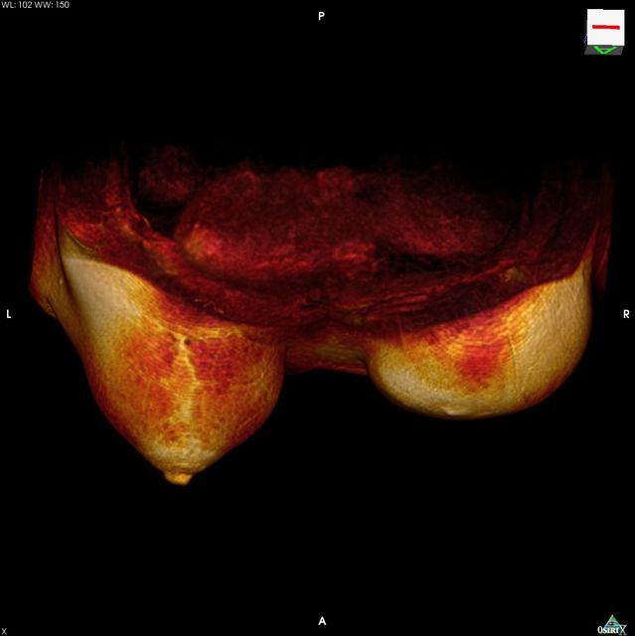
FIGURE 2
Superior (top-side) view of detectors around a patient:
(ii) Anterior stationary detectors integrated into the main unit;
(iii) Posterior retractable/removable
Posterior detectors –
retractable, removable
Volume rendered Breast MRI
with one partial mastectomy
Patient body
outline
Arm position
Curved, racetrack
detectors -- retractable
Anterior detectors -- stationary

Slide 3
FIGURE 1
Posterior (top-down) view of racetrack detectors (i)
MR/PET guided biopsy
lateral access when
retracted
Patient feet direction
Hinge
Detectors can be:
Continuous (the continuous version of what is shown here),
Monolithic blocks (a single crystal read-out by position sensitive detectors),
Discretized array blocks (multiple crystals on a position sensitive detector),
Completely discrete (one-to-one crystal-detector)
Patient head direction

